Slide 1
IN723 BGP Remotely Triggered Black Hole Filtering
Destination Based
Source Based
Unicast Reverse Path Forwarding (uRPF)

Slide 2
Resources
Cisco White Paper
http://www.cisco.com/c/dam/en/us/products/collateral/security/ios-network-foundation-protection-nfp/prod_white_paper0900aecd80313fac.pdf
Another Guide
http://packetlife.net/blog/2009/jul/6/remotely-triggered-black-hole-rtbh-routing/
Configuring BGP to Block Denial of Service Attacks
https://tools.ietf.org/html/rfc3882

Slide 3
The Problem
A common DoS attack directed against a customer of a service provider involves generating a greater volume of attack traffic destined for the target than will fit down the links from the service provider(s) to the victim (customer).
This traffic "starves out" legitimate traffic and often results in collateral damage or negative effects to other customers or the network infrastructure as well.
Rather than having all destinations on their network be affected by the attack, the customer may ask their service provider to filter traffic destined to the target destination IP address(es), or the service provider may determine that this is necessary themselves, in order to preserve network availability.

Slide 4
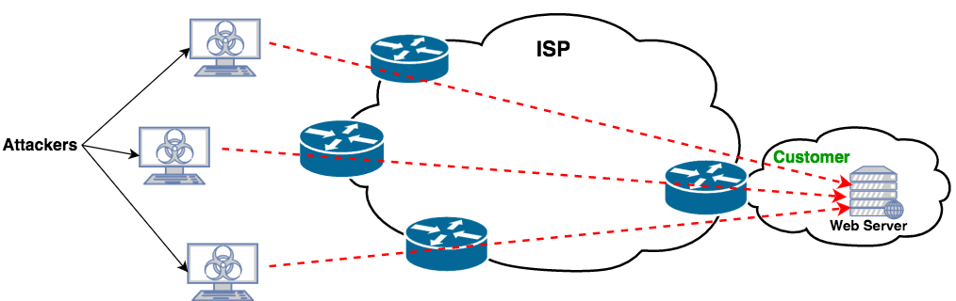
Denial of Service Attack

Slide 5
Solution - ACL
One method is to deploy access control lists on the edge of the network.
This technique provides flexibility in the filtering, however it runs into scalability issues, both in terms of the number of entries in the filter and the packet rate.
Most routers are able to forward traffic at a much higher rate than they are able to filter, and they are able to hold many more forwarding table entries and routes than filter entries.
It can take time to configure and deploy ACLs.

Slide 6
Solution A – RTBH – Destination Based
Destination-based RTBH filtering injects a discard route into the forwarding table for the target prefix.
All packets towards that destination (attack traffic and legitimate traffic) are then dropped by the participating routers, thereby taking the target completely offline.
The benefit is that collateral damage to other systems or network availability at the customer location or in the ISP network is limited, but the negative impact to the target itself is arguably increased.

Slide 7
Before RTBH
Notes:
Many ISP customers (not just the intended target) may be affected by the DOS attack as provider links are saturated.

Slide 8
After RTBH

Slide 9
RTBH Destination Based - Setup
The edge routers are preconfigured with a static route to null0.
For example, 192.0.2.1/32 is set to null0.
The IP address 192.0.2.1 is reserved for use in test networks and is not used as a deployed IP address.
Notes:
Null0 = a virtual bit bucket (trash can). Traffic directed to it is discarded.

Slide 10
RTBH Destination Based - Trigger
A specific router has the role of Trigger.
The Trigger must have an iBGP relationship with the edge routers.
The trigger is configured with a static route to the victim network/address with a next-hop of the null0 route on the edge routers e.g. 192.0.2.1
The static route is advertised to the edge routers.
The next-hop entry in the route-table of the edge router for the destination-ip is now set to null0.
All traffic destined will now be forwarded to null0 and dropped.

Slide 11
RTBH - Withdrawal
Once the threat has passed, the route is manually removed from the Trigger causing a BGP withdrawal message to be sent from the Trigger to the edge routers.
The original next-hop value is restored and traffic can resume being forwarded to the original DoS target.

Slide 12
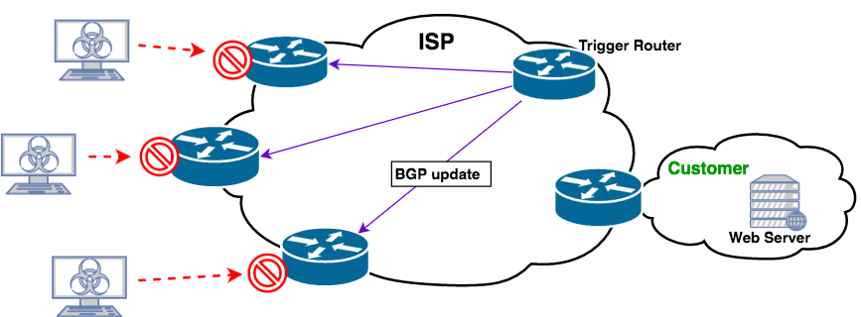
RBHF Solution

Slide 13
Configuration – Destination Based
Edge Routers
ip route 192.0.2.1 255.255.255.255 null0
Notes:
Note in VIRL this is also required on the Trigger otherwise the route for the Target network will not be advertised as 192.0.2.1 is an invalid next hop.

Slide 14
Configuration – Destination Based
Prepare Trigger Router with redistribution of static routes with an attached route-map
(config)# route-map RTBH
(config-route-map)# match tag 666
(config-route-map)# set ip next-hop 192.0.2.1
(config-route-map)# set origin igp
(config-route-map)# set local-preference 200
(config-route-map)# set community no-export
(config)# router bgp 65001
(config-router)# redistribute static route-map RTBH
Notes:
Once the trigger advertisement is sent to the iBGP peers, you need to make sure that the peers prefer this route to one that they already have for the destination network. One way is to set a local-preference value greater than the default value of 100 and set the origin to igp. The preferred method is to set a path with a higher value for local-preference and a lower value of origin (IGP is lower than Exterior Gateway Protocol [EGP], which is lower than incomplete).
BGP communities, which are attributes that are applied to prefixes and used to group and filter routes. Specifically, the no-export community is used within an autonomous system (AS) to make sure that the edge routers (PEs) do not export or readvertise the prefix used by the trigger advertisement to their external BGP (eBGP) peers.

Slide 15
Configuration – Destination Based
Configure Trigger Router with static route matching DoS target and with a tag value that is matched in the route-map.
(config)# ip route 172.16.10.100 255.255.255.255 Null0 tag 666
Notes:
Note the null0 specified here is not advertised. The actual next-hop advertised is that of the Trigger device’s peering address, however this is changed by the route-map to that of 192.0.2.1.

Slide 16
Verify
R1# show ip route 172.16.10.100
Routing entry for 172.16.10.100/32
Known via "bgp 65100", distance 200, metric 0, type internal
Last update from 192.0.2.1 00:06:14 ago
Routing Descriptor Blocks:
* 192.0.2.1, from 10.0.99.9, 00:06:14 ago
Route metric is 0, traffic share count is 1
AS Hops 0
R1# show ip route 192.0.2.1
Routing entry for 192.0.2.1/32
Known via "static", distance 1, metric 0 (connected)
Routing Descriptor Blocks:
* directly connected, via Null0
Route metric is 0, traffic share count is 1

Slide 17
Solution B - Source Based
By coupling unicast Reverse Path Forwarding (uRPF) techniques with RTBH filtering, BGP can be used to distribute discard routes that are based not on destination or target addresses, but on source addresses of unwanted traffic.
Note that this will drop all traffic to/from the address, and not just the traffic to the victim.

Slide 18
uRPF - overview
Enables a router to verify the reachability of the source address in packets being forwarded. This capability can limit the appearance of spoofed addresses on a network. If the source IP address is not valid, the packet is discarded.
2 Modes:
Unicast RPF strict mode = the packet must be received on the interface that the router would use to forward the return packet. Unicast RPF may drop legitimate traffic when asymmetric routing paths are present in the network.
Unicast RPF loose mode = the source address must appear in the routing table and must not be null0.

Slide 19
Solution - Source Based
URPF validates a source IP against its forwarding entry.
To drop traffic from specific source addresses, configure loose URPF on the external interface and make sure the RPF check fails by inserting a route to the source with a next hop of null0.
You can do this by using a trigger device to send iBGP updates. These updates set the next hop for the source IP to an unused IP address that has a static entry at the edge, setting it to null0
Configuration is in the Lesson 10 Lab

